Slide 1



Slide 2
MALAIYAPPAN M
2002 | BE | ELECTRICAL ENGG | Govt College of Engg Bargur
2004 | ME | PED | College of Engg Guindy, Anna University Chennai
15 Years Exp in Power Electronics R&D

Slide 3
Pantech Solutions
Manufacturer of Educational Equipments
Technical Training Company
DIY Kits for Engineering Group

Slide 4




30 DAYS MATLAB SIMULINK – ELECTRICAL ENGG
Power Converters
Energy Resources
Solar/Wind
Sensors
Motors
Digital Controllers
(ARDUINO, TIDSP)

Slide 5
Essential Tool for Electrical Engineering
MATLAB – SIMULINK
CADENCE
ANSYS
MATCAD/EMTP

Slide 6
Application Block Diagram
Input
Power Circuit
Load
Controller

Slide 7
Target Industry
01
02
03
Silicon | Semiconductor
Power Management System
Motion Control System

Slide 8
30 DAYS AGENDA
Day 1 - MALTAB SIMULINK FOR ELECTRICAL ENGINEERING
Day 2 - Arduino Examples with MATLAB SIMULINK
Day 3 - Arduino Based Speed Control of DC Motor using MATLAB
Day 4 - Single/Three Phase Rectifier using MATLAB
Day 5 - Single/Three Phase AC Voltage Controller using MATLAB
Day 6 - DC-DC Converter using MATLAB
Day 7 - Inverter Design using MATLAB
Day 8 - Grid Tie Inverter Design using MATLAB
Day 9 - Matrix Converter using MATLAB
Day 10 - Multi Level Inverter Design using MATLAB SIMULINK
Day 21 - Buck/Boost Converter Design Procedure with Arduino
Day 22 - Wind Energy Power System Design
Day 23 - Smart Energy Meter System Design using Arduino
Day 24 - Three Phase Induction Motor Fault Diagnosis using Arduino
Day 25 - TI DSP Programming using MATLAB
Day 26 - SMPS Design Calculations and Fabrication
Day 27 - Electric Vehicle Design using MATLAB
Day 28 - Facts Devices using MATLAB
Day 29 - Vector controlled Induction Motor using Simulink
Day 30 - Hardware design for Arduino based Speed Control of Induction Motor
Day 11 - Active Power Filter Design using MATLAB SIMULINK
Day 12 - Battery Charger design using MATLAB SIMULINK
Day 13 - Speed Control of DC Motor Using Chopper
Day 14 - Simulink Based Speed Control of Induction Motor
Day 15 - Simulink Based Speed Control of BLDC Motor
Day 16 - Simulink Based Speed Control of PMSM Motor
Day 17 - MPPT Controller for Solar PV Application
Day 18 - Gate Driver Design for IGBT /MOSFET
Day 19 - AD/DC Current/Voltage/Speed Measurement Circuit
Day 20 - Inductor/Transformer Design

Slide 9

DAY1
MATLAB SIMULINK
30 Days Master Class

Slide 10
Agenda
History of MATHWORKS
Introduction to Simulink
MATLAB for Electrical Engineering
Model Design for Signal Generation
Sin wave, Triangular wave
Subsystem
Counter
Logic Condition
Counter Design

Slide 11
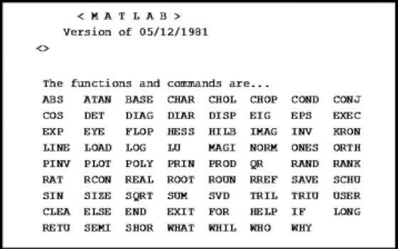
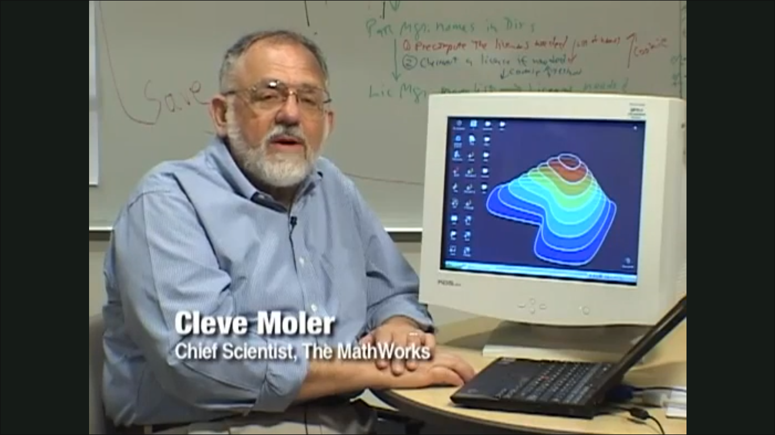

Matrix Calculator 1980s
Founder: Cleve Moler
Jack Little
Chief Mathematician
President
IEEE Conference on Decision and Control, in Las Vegas in December, 1984

Slide 12
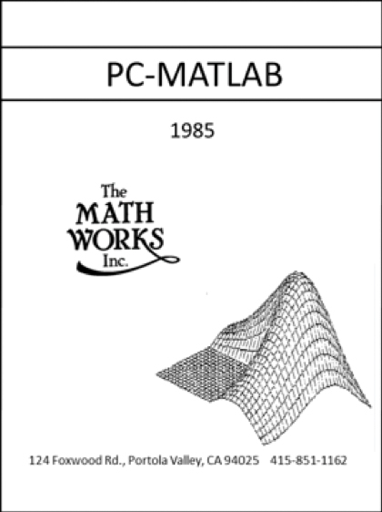
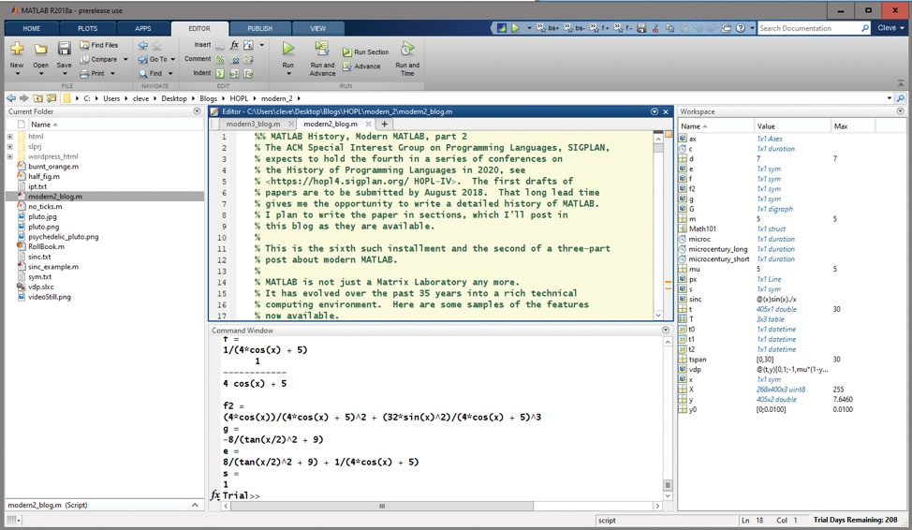
MATrix LABoratroy December 1984

Slide 13
MATLAB History
Year | Releases
1984 | MATLAB 1
2002 | MATLAB Simulink
2004 | Integer data types, Function handles, Parallel computing
2010 | GPUs
2020 | Live Editor, Tall arrays and categorical arrays

Slide 14
Simulink
Simulation and Model Based Design
Graphical Programming Environment
Modeling
Simulation
Analysing multi domain dynamical system

Slide 15
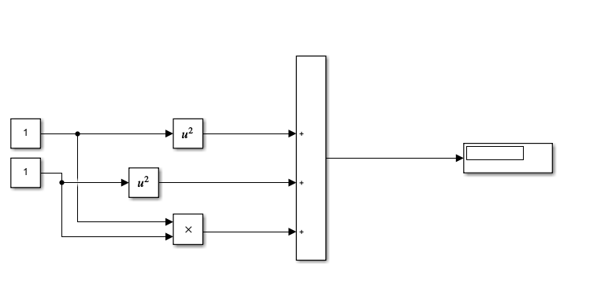
Simulation and Model Based Design

Slide 16
MATLAB for Electrical Engineering
Physical Modeling & Mathematical modeling of Electrical Concepts
Power Electronics Circuits
Electric Circuits
Digital Logics
Electric Motors
Electric Vehicles
Renewable Energy Sources
Power System Concepts

Slide 17
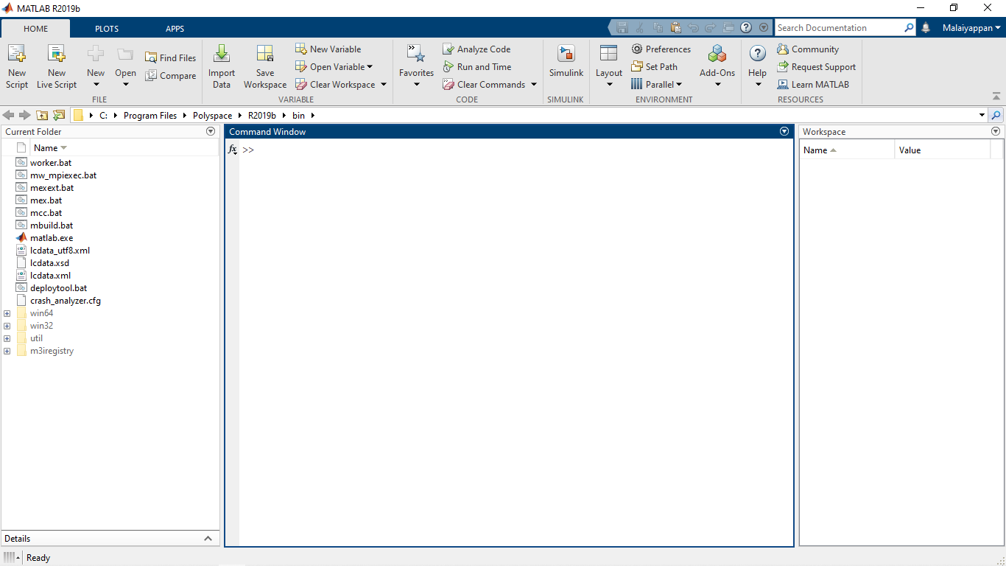
Examples
MATLAB WINDOW
Options Icons
Essential Components
Simulink Icon
Input, Output, Logic Functions, General Components
Waveform Generation
For controlling of Electrical Parameters
Command Window
Work Space
Subsystem Design
For better design
Work Directory

Slide 18
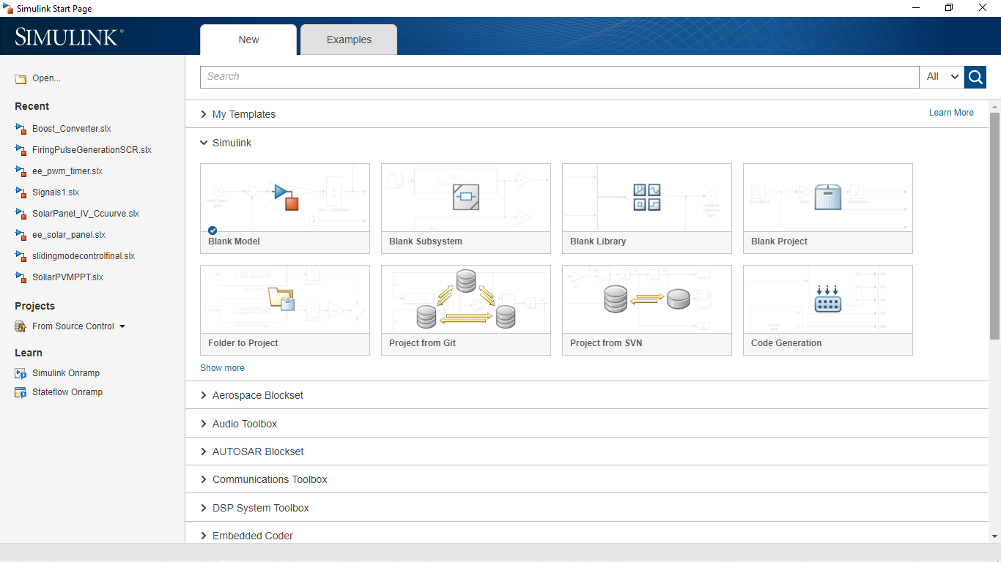
Simulink
Simulink Options
Work Directory

Slide 19
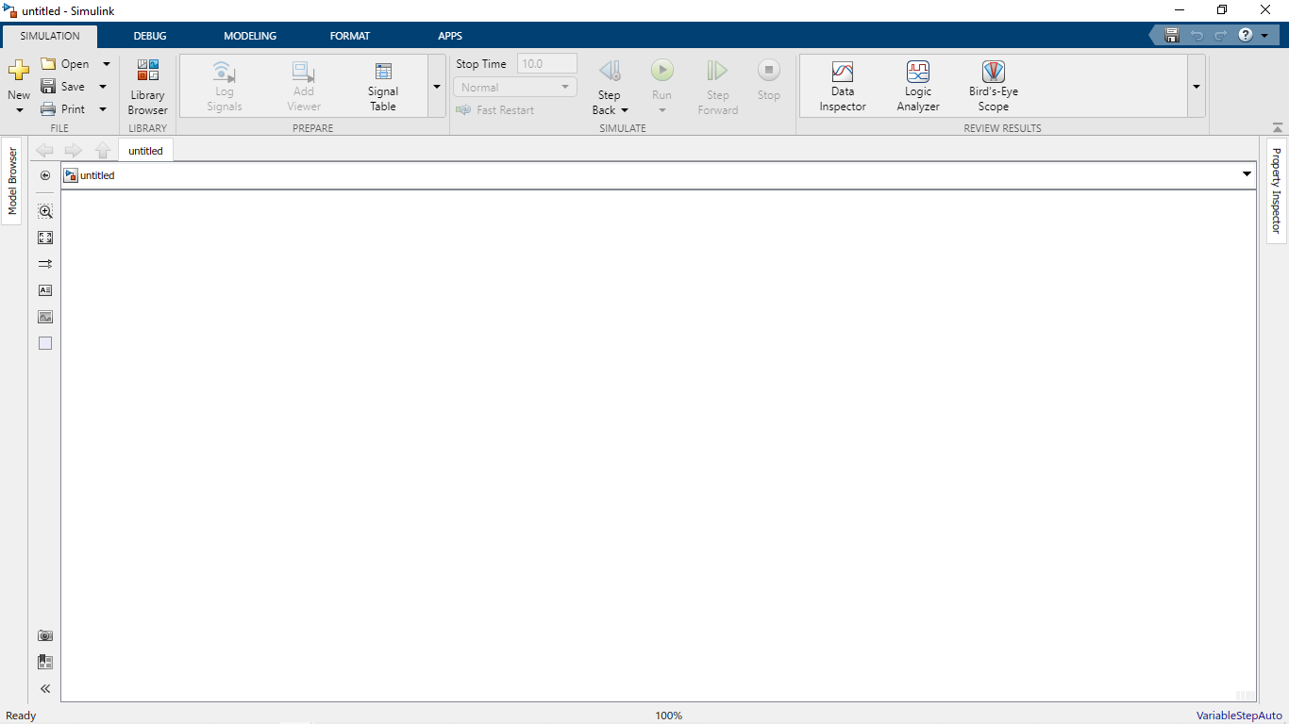
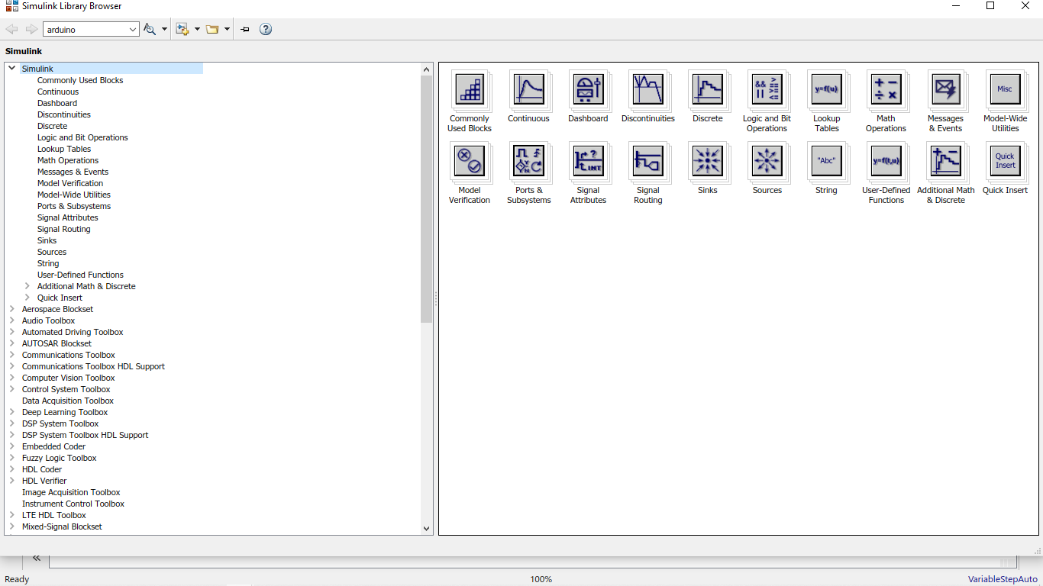
Project Window

Slide 20
Example 1
Y= a² + b² + 2ab

Slide 21
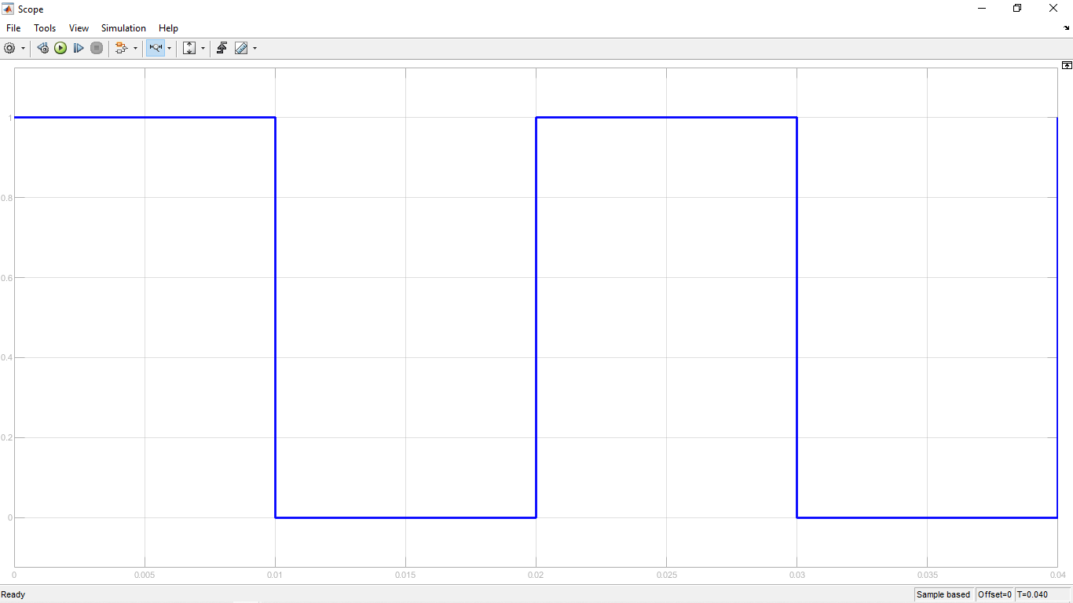
Ex2: Square Wave
Pulse Width
Frequency : 50Hz
Period (in Sec) : 20ms or 20e⁻³ sec
Pulse Width : 50%
Period or Frequency

Slide 22
-Consistancy is the Success

Slide 23
THANKS

